Slide 1
“Returning Alumni Will Find Change”
Social Change at Carolina in the early 1970s

Slide 2
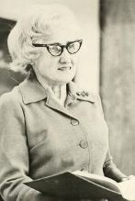
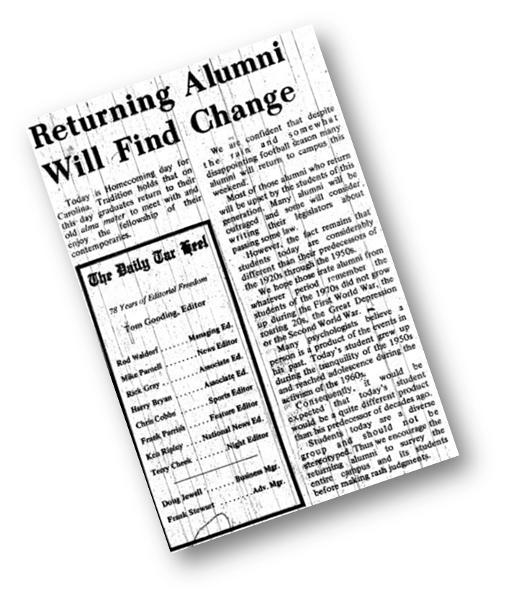
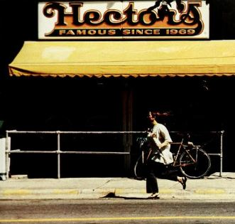
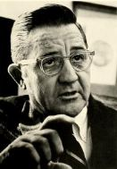
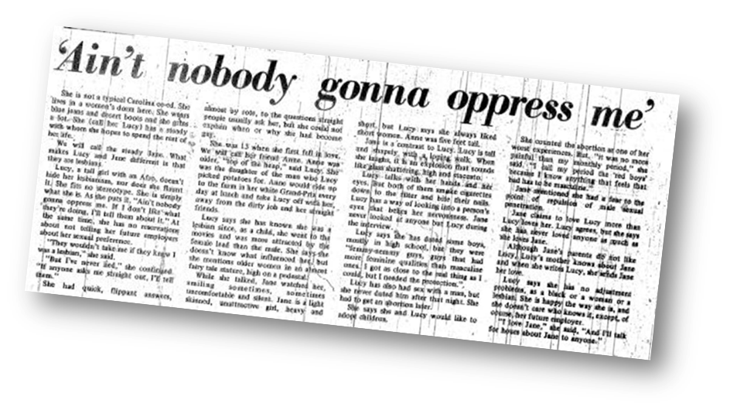
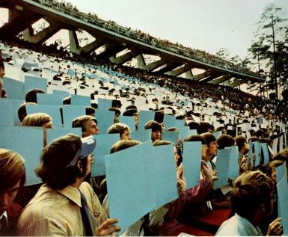
Carolina in the early ‘70s
Enrollment | 1973
Male | 11,946
Female | 7,278
Undergraduate | 13,085
Graduate | 6,139
Out-of-State | 4,421
In-State | 14,803
Total | 19,224
Cost | 1973
Tuition (In-State) | $242
Tuition (Out-of-State | $1,817
Fees | $197
Room and Board | $980
Total (In-State) | $1.419

Slide 3
The soundtrack of Social Change
Jubilee and other campus concerts

Slide 4
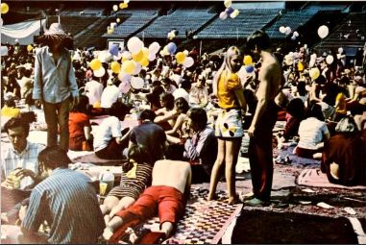
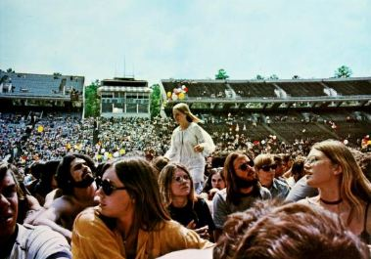
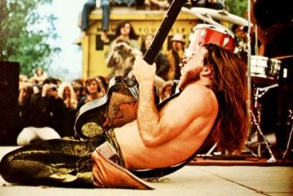
Jubilee

Slide 5
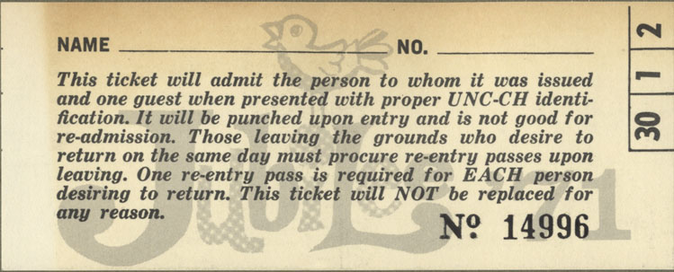
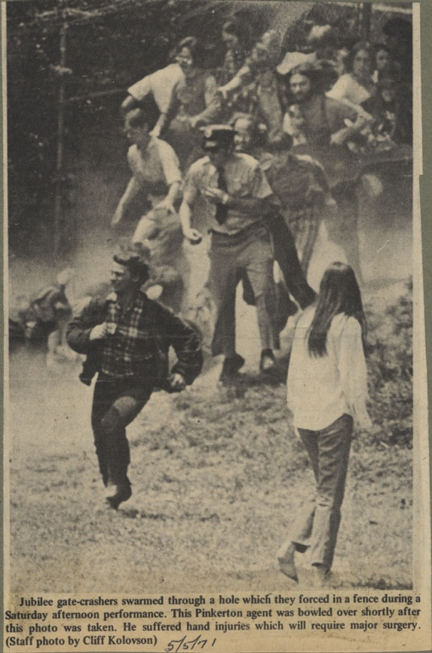
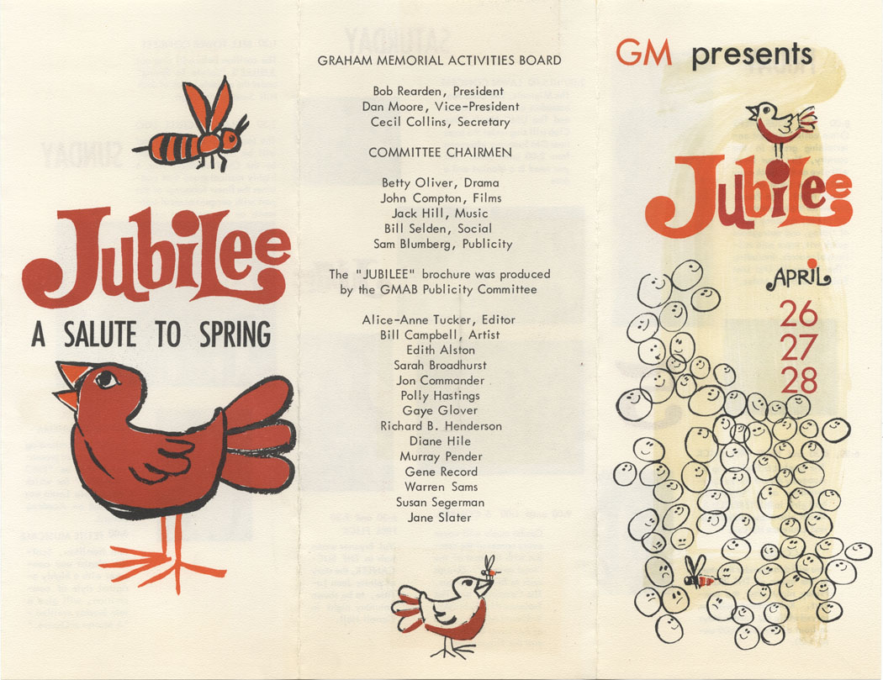
Jubilee (cont.)
http://www.youtube.com/watch?v=4eo-TMK40A4

Slide 6
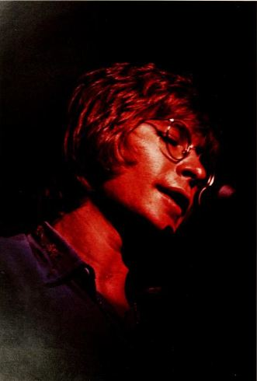
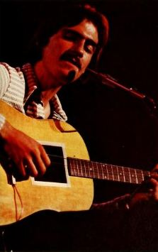
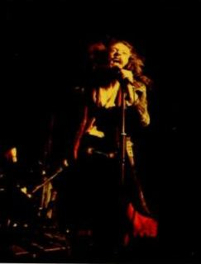
Other Performances
John Denver in 1972
James Taylor in 1973
Jethro Tull in 1972

Slide 7
A Different Kind of Pit Sitting
Student Protests of Vietnam and Workers Rights

Slide 8
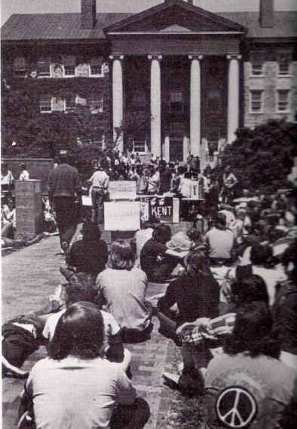
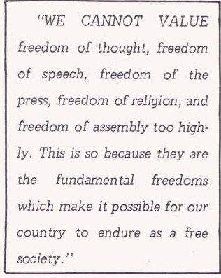
Campus right to dissent
Notes:
From Alumni Review, June 1970:”Rights and Limits of Dissent On Campus Cited by Senator Sam Ervin,” page 24.

Slide 9
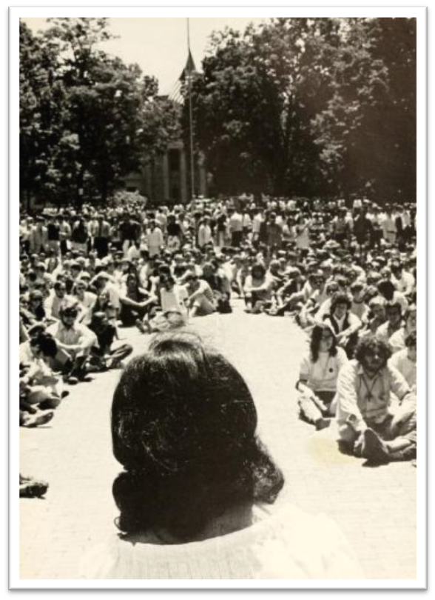
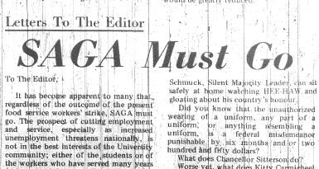
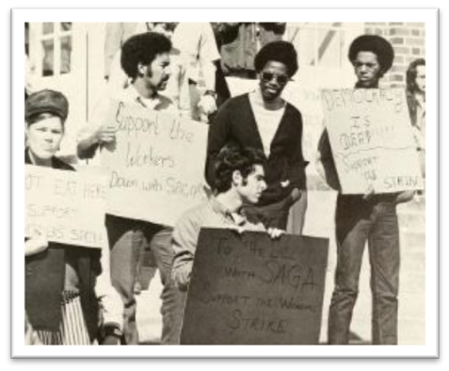
SAGA and Workers Rights

Slide 10
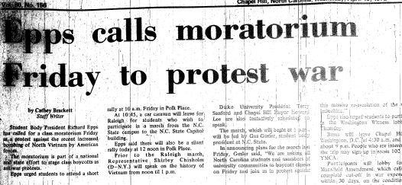
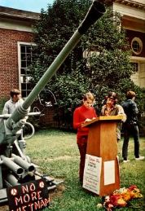
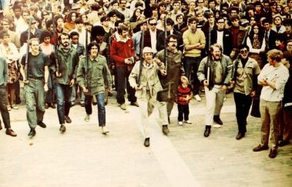
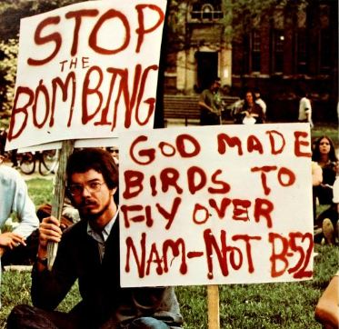
Vietnam War Protests

Slide 11
BREAKING RACIAL BARRIERS
Changes in racial attitudes

Slide 12
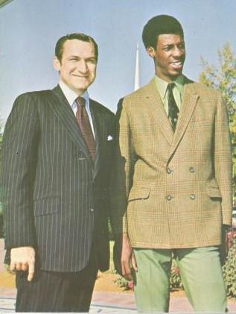
Desegregation of Athletic Program
Charlie Scott,
First African-American Scholarship Basketball Player,
UNC 1967 - 70.

Slide 13
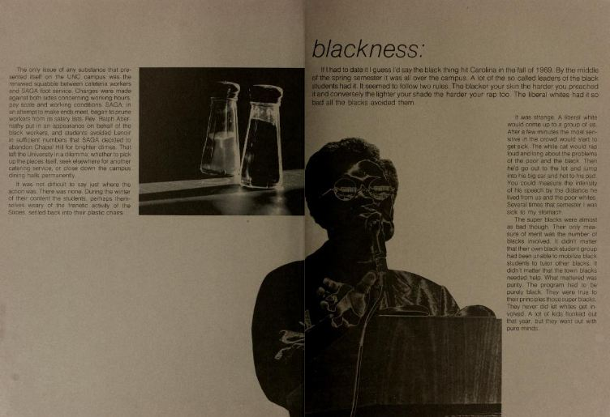
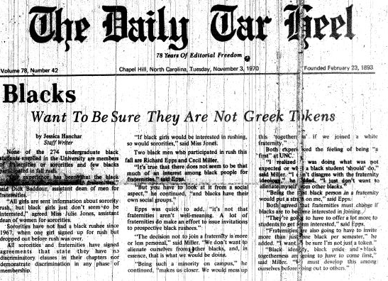
Race in Campus Media

Slide 14
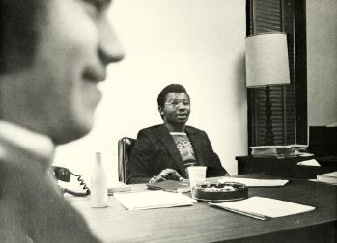
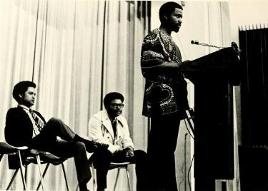
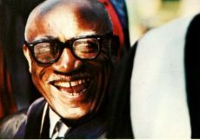
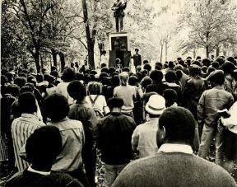
African American Leaders and the Black Student Movement
Richard Epps,
Student Body President, 1972-73.
Dr. Blayden Jackson, First African American Full Professor.
Roberta Jackson, First tenured African American female faculty member.

Slide 15
BREAKING GENDER BARRIERS
Changes in Carolina Co-eds

Slide 16
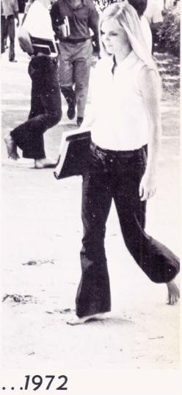
Change in Carolina Co - Eds
Surveyed 1970’s senior women revealed attitudes of changing roles in society including -
A desire for more time for personal development and fulfillment outside the home.
Intended sustained work careers; return to work after children were grown
Belief that men and women should share equally in making household and family decisions, housework and childcare
Greater independence and equality
Notes:
From Alumni Review, January 1973, “Have Carolina Co-eds Changed,” page 12; also Carolina Alumni Review, May 1973, “The Seventy-Fifth Anniversary of the Coming of Women to the University of North Carolina,” insert after page 12.

Slide 17
Continuing Co-Ed Breakthroughs
1971 – First woman granted a graduate Morehead Fellowship (Norma Harrell)
1971 – President of Phi Beta Kappa (Judith Hippler)
1972 – First women tapped for membership in the Order of the Golden Fleece (Mary N. Preyer, Deborah A. Potter, Katherine V. Carlton, Anne E. Green)
1973 – Again, woman elected editor of the Daily Tar Heel (Susan Miller)

Slide 18
CHANGES IN THE military draft
Selective Service Deferments, Lotteries and End of the Military Draft

Slide 19
Selective Service Status for Entering Freshmen
Registered with Selective Service at age 18
Eligible for deferment during tenure as a student in good standing
Eligible for exemption including “Conscientious Objector”

Slide 20
Establishment of Draft Lottery November 1969
1st lottery held December 1, 1969
Determined order of call to duty for calendar year 1970

Slide 21
End of Student Deferments in 1971
Divinity students exempted
Draft Board membership criteria changed to better reflect proportionately the ethnic and cultural make-up of the communities served

Slide 22
Military Draft Ended January 1973
Creation of all-volunteer armed forces announced
January 27, 1973, ending draft.

Slide 23
Barely Legal
Partying, Drugs, and Alcohol

Slide 24
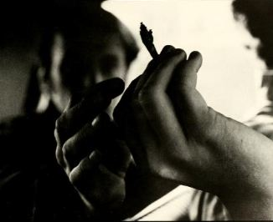
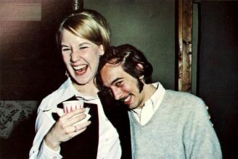
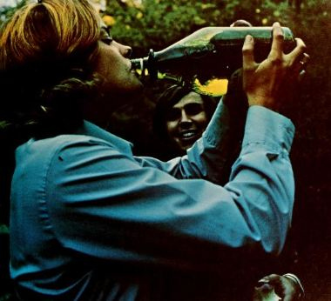
Alcohol and Drugs on Campus

Slide 25
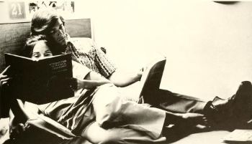
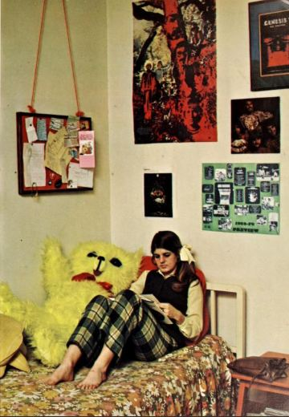
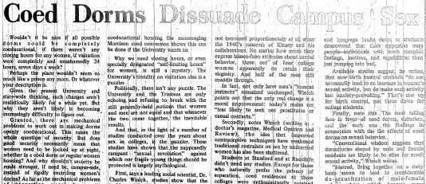
Co-eds

Slide 26
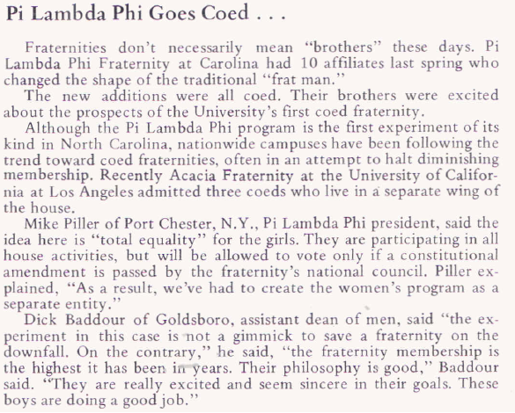
Alumni Review, CAMPUS CAPSULES, June 1970

